Slide 1

Hackathon @Endeavour
By Team_Gridlock.

Slide 2

Aim
We made an application for smart traffic management. We chose this domain, as this is quite a wide spread problem and people everywhere is facing it everytime they are on the roads. So we tried to come up with a solution in a much more practical and interactive way to help with this problem. Our database uses real time data sent by the users to monitor traffic for a particular area and also to give the stats about the roads, if they are okay to be travelled with.

Slide 3
A.T.S Applications :
Automated Traffic Management Systems (ATMSs): manage the flow of road traffic using a variety of technologies.
e-tolls: electronic toll booths deduct toll payments without stopping.
Electronic Road Pricing (ERP): requires drivers to pay different tolls at different times.
Traveler Information Systems: provide online, real-time information on road conditions.
Route guidance system: helps a driver navigate the best routes to a given location.

Slide 4
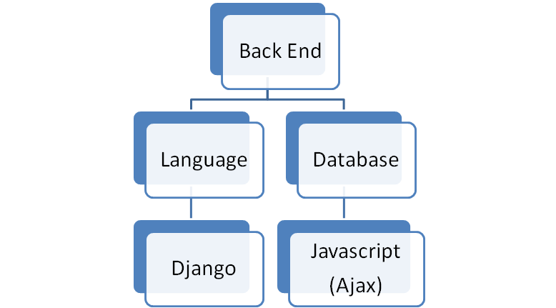
Technologies used.

Slide 5
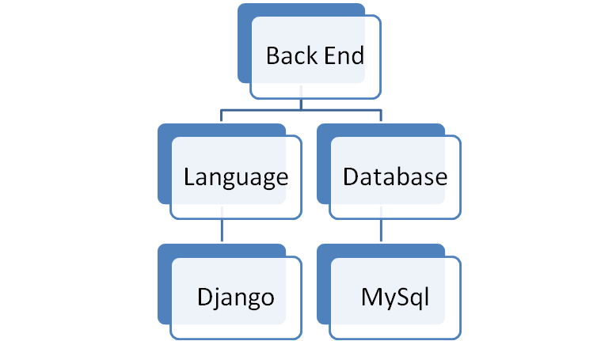

Slide 6
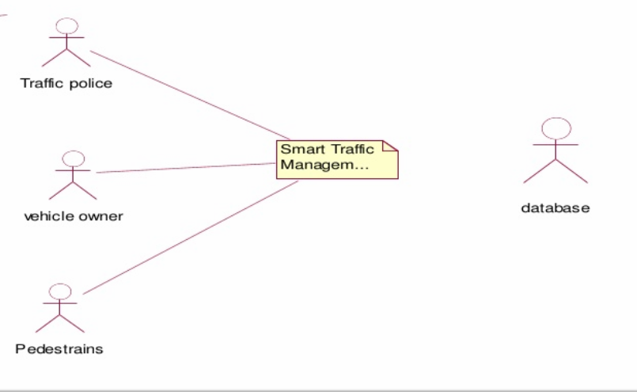
Overall Description And Working.
System Environment

Slide 7
Our system has three active actors one cooperating system. Mainly pedestrians, Traffic police and vehicle owners uses the dataset provided by the admin to give in all the info about the road and traffic status.
Software Interface:
Client : Web Browser, Android System
Web Server : DJango
Data Base Server : MySql
Development End : Python, Javascript, HTML, CSS.
Communication Interface:

Slide 8
•Client on Internet using will be using HTTP/HTTPS protocol.
•TCP/IP protocol is basic need for client side.
User Characteristics:
User should be comfortable using web browser.
User has to register with the STM.
Every user should have a unique user id and password.

